Slide 1
Modern Data Warehouse
What the Hack
June 2020

Slide 2








Introductions
Ask the Experts
Chris Mitchell -- Advisor
Alex Karasek – Lead Developer
CH2,3,4
Annie Xu – Data Developer
CH5
Jason Virtue – Captain of the …
CH1
Coaches / Editors
Brian Hitney
Halaa Menasy
Israel Ekpo
Peter Laudati

Slide 3

Intermission
Please start Challenge 0 and setup your environment.
Raise your hand when SQL VM is being deployed

Slide 4
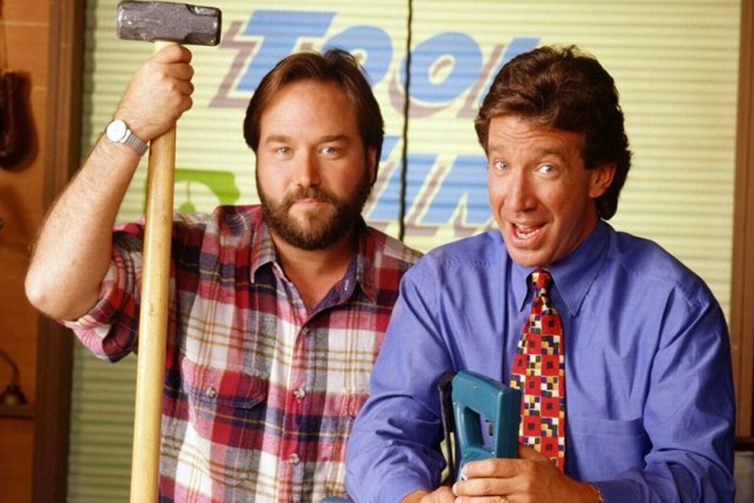

This Old [Title]House WTH {“Title”: [“Data Ware”, “Data Lake”, “…..”]}
WHEN: June 9 to 11th
TIME: 10am to 6pm EST
WHERE: Virtual Hack
Registration: https://aka.ms/WTHMDWJune2020
AKA: What the Hack: Modern Data Warehouse
Brought to you by: OCP Swarm

Slide 5

Notes:
Welcome to our What the Hack. If you are not afraid of these animals or getting to close you are in the right place. There are no fences or cages for our hack just our zookeepers (Coaches) who will guide you thru the Hack. They are hear to help you learn and provide the right hints without giving away the answer.

Slide 6

Notes:
You will want to work together in a team and not work alone. These challenges are difficult and will require dividing up the work and learning from each other to escape this room. Our audience are data engineers who are at level 200 who want to advance to level 300 or 400.

Slide 7

Notes:
At the end of this hack you will be the master zookeeper who can keep all these animals of the Big Data Zoo in their cages and helping you scale your data workloads.

Slide 8

Logistics
Notes:
And now we’ll cover logistics…

Slide 9
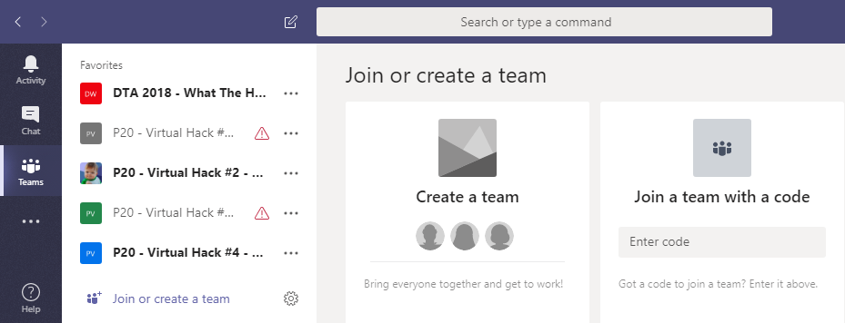
Collaboration
Step 1: Join the Team!
Team: “-- insert Teams team name here --”
Join Code: “-- join code here --”
#2
#1
-- join code --

Slide 10
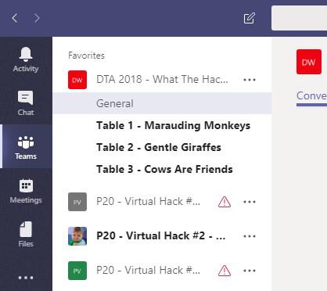
Collaboration
Step 2: Create a Channel for your table’s team!
Name your team something unique and fun, but prefix with your table #!
Team: “-- insert Teams team name here --”
Join Code: “-- join code --”

Slide 11
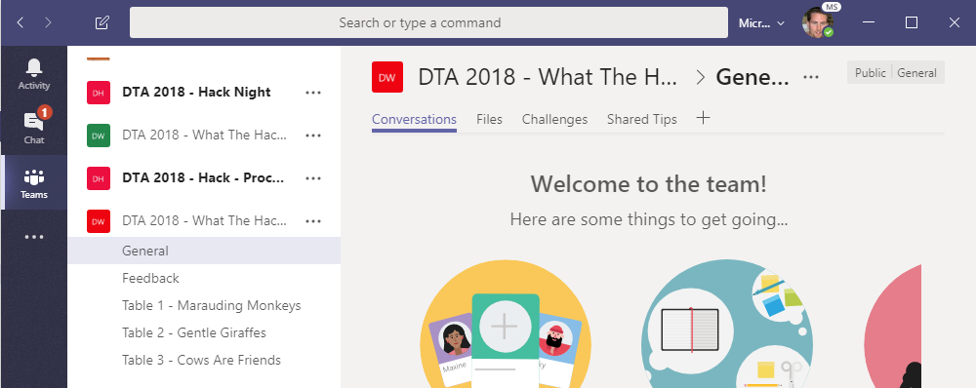
Collaboration
Step 3: Collaborate!
-- join code --
Hang out, communicate, talk, and screenshare with squad members in your squad’s channel
DURING & after the event, share feedback with the proctors in the Feedback channel. This will help them improve the event as it progresses and make the next one even better
Find any files, resources, or code samples, and THIS presentation here!
Challenges will be posted here by the proctors throughout the event
Share tips, tricks, gotchas (how you solved them), code snippets, and links you learn along the way here with everyone

Slide 12
-- join code --
Format
Challenges are cumulative, building upon each other.
Establish Confidence – start small and simple (think hello world)
Build Competence – by having successively more complex challenges
Challenges are NOT step-by-step hands on labs!
No “clicking here” or “copy n pasting there”
Challenge definitions are short. A couple of sentences or bullet points stating the end goal(s) and perhaps a hint at the skill(s) needed.
You MUST work together as a team to figure out how to complete them!

Slide 13
-- join code --
Format
For each challenge we will deliver a ”mini-lecture” explaining concepts in it.
We’ll review results for each challenge when it looks like a majority of folks have completed the challenge
Don’t be beholden by the clock!
Move quickly or take it slow.
Your proctors are here to help you.
There WILL be more challenges than you can complete in our allotted time!
These are takeaways for follow up at home or with customers!

Slide 14
-- join code --
Proctors
Each team will have a proctor through-out the whole hack.
Use them! But don’t expect them to give you all the answers.
Get to know your proctor, their likes and dislikes...
All the better to find a bribe that works!
Notes:
Keep the teams working as teams!
Encourage all to “learn from” and “share with” each other!
If you observe individuals racing ahead, encourage them to help those who are behind.
Encourage attendees to use their team’s channel on MS Teams to collaborate/share info!
Unblock teams who get stuck
Encourage team members to unblock each other first!
Provide hints, but not answers
If you observe individuals stuck for a while, help them get moving so they don’t lose interest.
Provide hints/pointers to the teams on how to solve problems & where to find information.
Use the answers/solutions in the proctor’s guide, but don’t share with the attendees
Proctor’s guide won’t be comprehensive. As SMEs, proctors should use their knowledge to help with solution hints/ideas.
Notify the emcee of unexpected blockers that arise during the event so they can be communicated to all, and recorded for future reference.

Slide 15
-- join code --
Tooling
You can use any tooling you want, but we strongly encourage (and will only support the following):
-- insert your list of required tooling here --
-- Eg: Visual Studio Code
-- Eg: Windows Subsystem for Linux with the Azure CLI installed.

Slide 16
-- join code --
Finding Answers
Search engines are your friend! Azure is a hot technology and much ink has been spilled on it.
The Azure docs are your best bet.
Many of the related open source projects used here have top notch documentation!

Slide 17
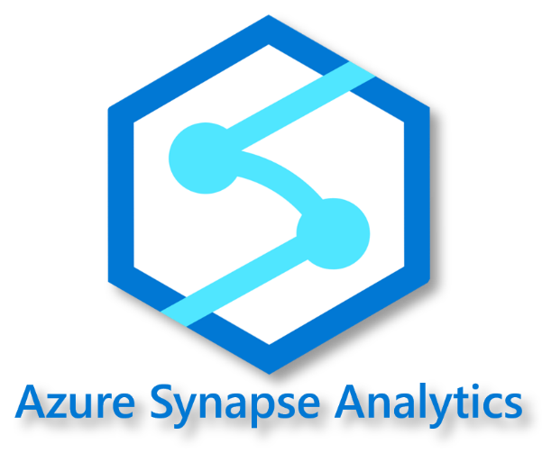
Introduction
Modern Data Warehouse is a key upgrade motion for organizations to scale out their on-premise analytical workloads to the cloud. This hack will help data engineers and administrators upgrade their skills to migrate to Azure Synapse Analytics. The hack will be the sequential migration steps required to migrate from on-premise to Synapse Analytics and re-platform attached workloads like ETL and reporting.

Slide 18
Learning Objectives
Migrate on-premise Data Warehouse to Azure
Architect data platform to scale
Build Batch & real-time pipelines for data movement
Design Synapse for optimal performance

Slide 19
Challenges
Data Warehouse Migration
Data Lake Integration
Data pipeline Migration
Realtime Data Pipelines
Analytics Migration

Slide 20
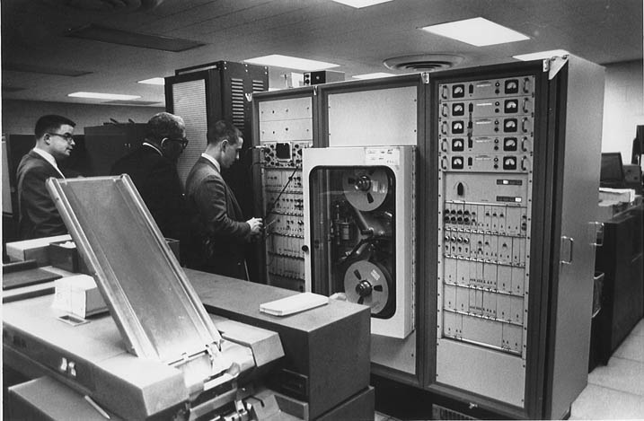
Traditional Data Warehouse
Insert Code Here
Notes:
At the end of this hack you will be the master zookeepr who can keep all these animals of the Big Data Zoo in their cages and helping you scale your data workloads.

Slide 21





Traditional Data Warehouse
Incremental
(Daily)
WWI OLTP
(SQL2017)
SSIS Runtime
WWI OLAP
(SQL 2017)
Power BI Premium
Power BI
Customer DC

Slide 22

Modern Data Warehouse
INGEST
STORE
PREP & TRAIN
MODEL & SERVE
Sensors and IoT
(unstructured)
Azure Databricks
Logs (unstructured)
Apache Kafka for HDInsight
Cosmos DB
Real-time apps
Media (unstructured)
Files (unstructured)
PolyBase
Business/custom apps
(structured)
Azure Data Factory
Azure Blob Storage
Azure SQL Data Warehouse
Azure Analysis Services
Power BI
Microsoft Azure also supports other Big Data services like Azure IoT Hub, Azure Event Hubs, Azure Machine Learning and Azure Data Lake to allow customers to tailor the above architecture to meet their unique needs. [LINK]
Notes:
Microsoft Azure supports other services like Azure HDInsight, Azure Data Lake, Azure IoT Hub, Azure Events Hub in various layers of the architecture above to allow customers a truly customized solution.

Slide 23








Reason for a Data Lake
Data Lake
Rapid Data Innovation (Self-service, Data Experimentation)
Unstructured Data (Images, Videos)
IOT Telemetry/Data (Semi-Structured)
Streaming Data
Archive Data
Just in-case data
Structured Data (Big V)

Slide 24

Enterprise Launch
Today’s State
Future State
Journey to get there

Slide 25
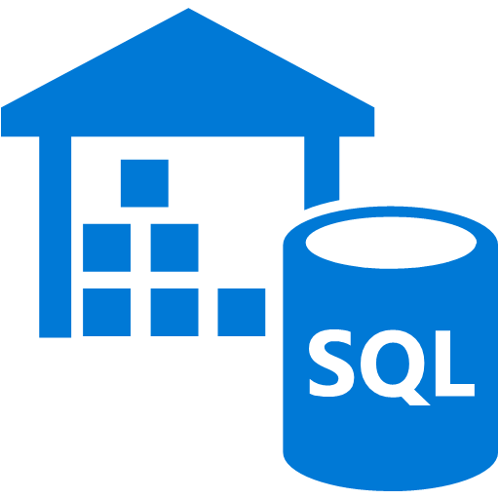

Modern Data Warehouse WTH (Phase I)
Release Deliverables
Migrate Data Warehouse to Azure Synapse
Lift & Shift SSIS to Azure Data Factory
Leave Source systems on-premise
Release Goals
Scale-out Data Warehouse architecture
Support Hybrid Architecture
Agile Delivery
Incremental
(Daily)
WWI OLTP
SSIS Runtime
Data Migration (Historical)
WWI OLAP
Azure Synapse Analytics
Customer DC
Azure

Slide 26

Modern Data Warehouse WTH (Phase 2)
Release Deliverables
Build out Azure Data Lake Store
Extract & Store data in Lake with ADF
Release Goals
Leverage Lake as Staging area
Support new data file types and structure
Support larger data sizes
Incremental
(Daily)
WWI OLTP
WWI OLAP
Azure Data Lake Store
Azure Synapse Analytics
Customer DC
Azure

Slide 27

Modern Data Warehouse WTH (Phase 3)
Release Deliverables
Ingest data from lake into Synapse
Replace SSIS jobs with Azure Data Factory
Build out ELT pipeline for scale
Release Goals
Shorten load windows
Data Science sandbox
Incremental
(Daily)
WWI OLTP
Azure Data Factory
Data Migration (Historical)
WWI OLAP
Azure Data Lake Store
Azure Synapse Analytics
Customer DC
Azure

Slide 28


Modern Data Warehouse WTH (Phase 4)
Release Deliverables
Setup real-time pipeline with Kafka
Transform data in real-time with Databricks
Interactive Queries
Release Goals
Reduce Time to Insights
Expand community thru multiple languages & tools
Incremental
(Daily)
WWI OLTP
Azure Data Factory
Data Migration (Historical)
WWI OLAP
Azure Data Lake Store
Azure Synapse Analytics
Streaming Data
(Real-time)
WWI OLAP
Azure HDInsight Kafka Cluster
Azure Databricks
Customer DC
Azure

Slide 29
Modern Data Warehouse WTH (End State)
Release Deliverables
Dashboard & Analytics with Power BI
Performance tune data & model in Synapse
Release Goals
Self-service reporting
Always-on SaaS Environment
Incremental
(Daily)
WWI OLTP
Azure Data Factory
Data Migration (Historical)
WWI OLAP
Azure Data Lake Store
Azure Synapse Analytics
Power BI Premium
Power BI
Streaming Data
(Real-time)
WWI OLAP
Azure HDInsight Kafka Cluster
Azure Databricks
Customer DC
Azure

Slide 30

Data Engineering at Scale

